Slide 1
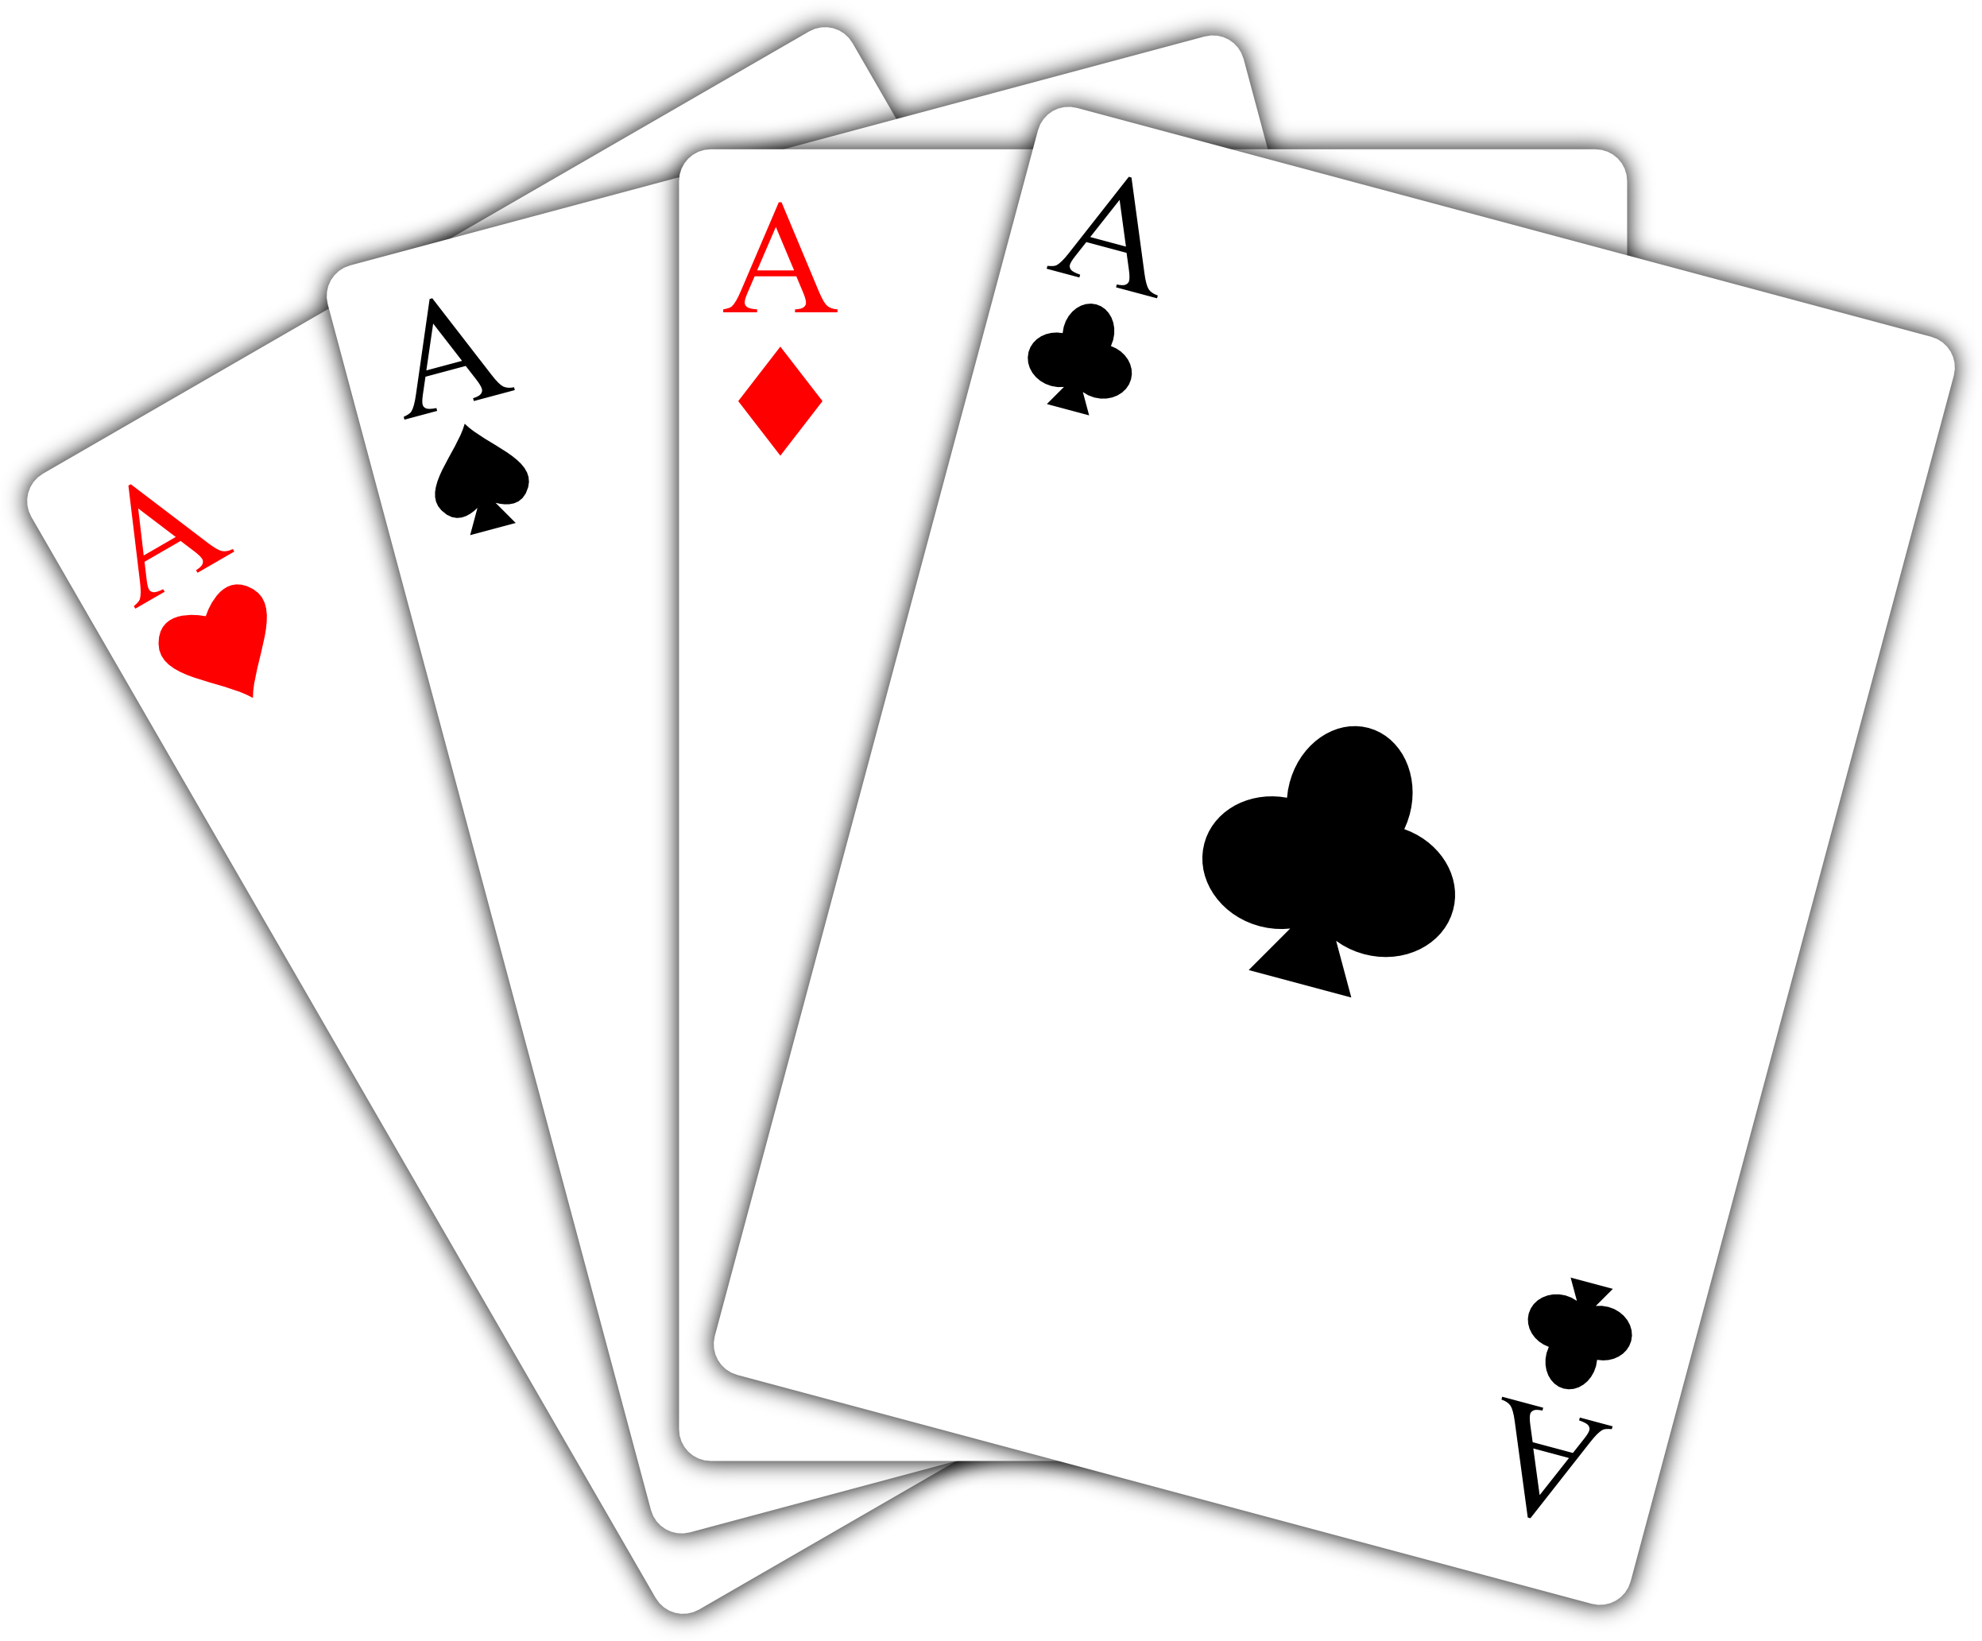

Gambling Simulator 25
A project by Sigma Technologies Inc.
Ares Gabrielyan, Mark Moutter, Michael Lulic, Iles Belkessam
Integrative Project, 420-204, Winter 2025
Vanier College

Slide 2
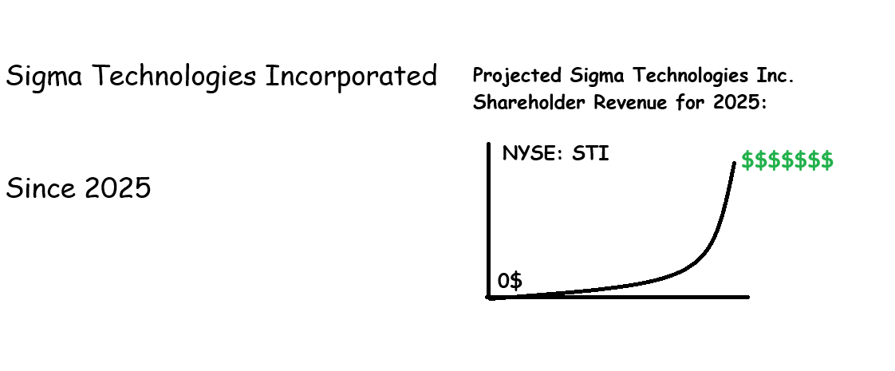
About Sigma Technologies Inc.
The passionate leadership of Sigma Technologies Inc. strives to maximize shareholder revenue while keeping development costs to a minimum.
To achieve this, STI will provide Minimum Viable Products (MVPs) to shareholders, while ignoring payroll and insurance expenses of employees. This allows for optimal revenue.

Slide 3
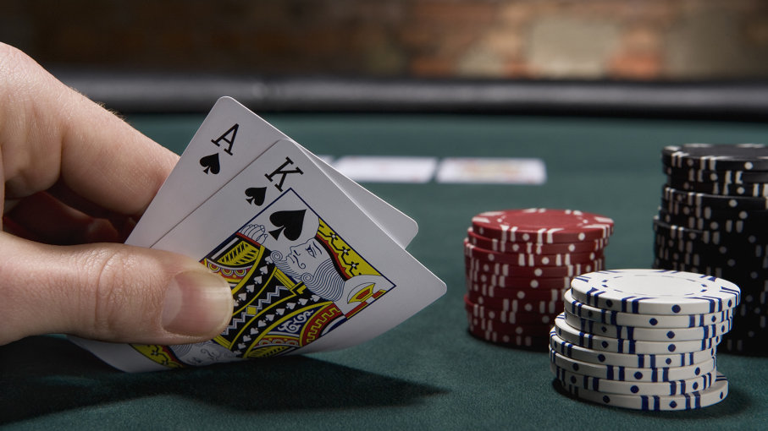
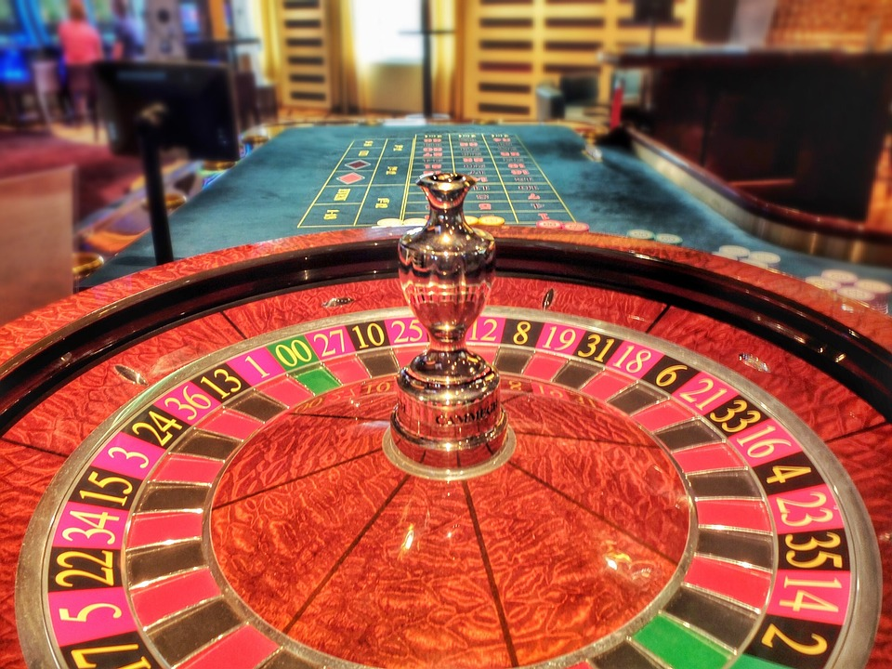
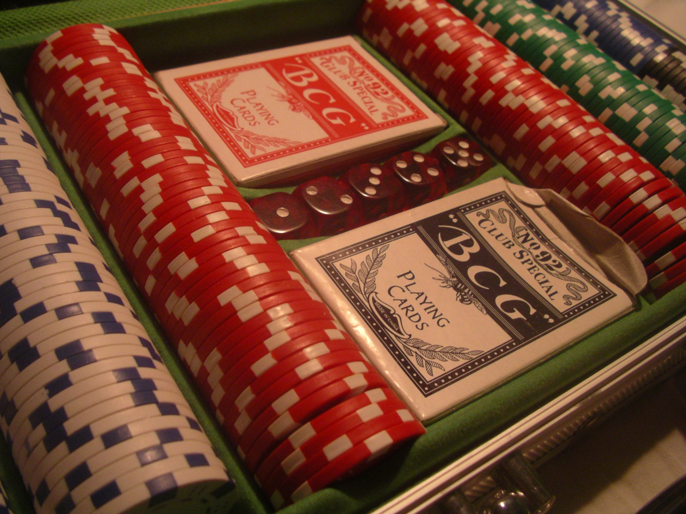
Context
In search of perfecting the project ideas, Sigma Technologies proposed the following ideas:
Discord-like encrypted chat application
Billiard collision simulation
Ragdoll sandbox simulation

Slide 4
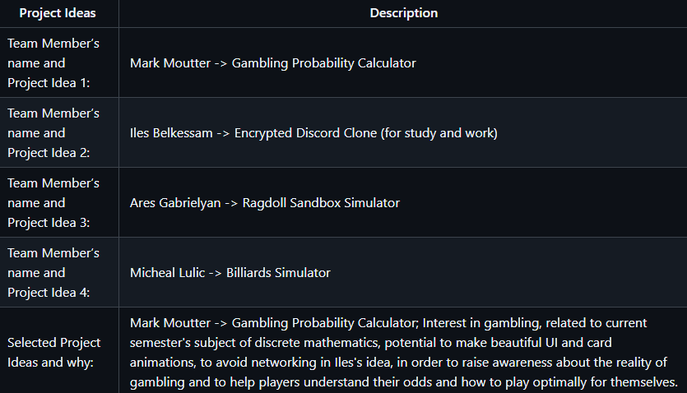

Final project choice
Finally, the retained idea by Sigma Technologies ended up being:
Gambling Probability Simulation Application

Slide 5
Proposed features
-Selection of games (Poker, Blackjack, and Roulette, etc)
-Ability to place imaginary bets and play normally
-Visibility of house edge
-Statistics window showcasing chances of winning, losing, receiving certain cards/results and optimal bets
-Ability to view decks and hands in simulated situations
-Informational tips about each game
-Graphs and visual representation of statistics

Slide 6


Addressed problems
Gambling addictions
The application could help to show how gambling isn’t profitable for the player in the long run through statistics
Aid in demonstrating optimal play in order to avoid losing money

Slide 7
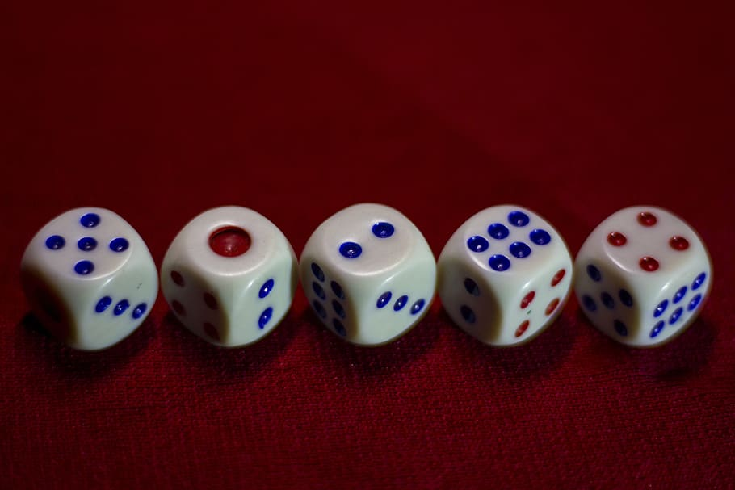
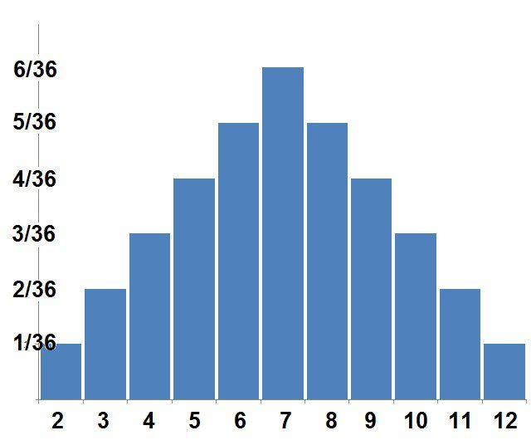
Related topics
Discrete mathematics: combinatorics, game theory, cryptographie
Probability Analysis
ML

Slide 8
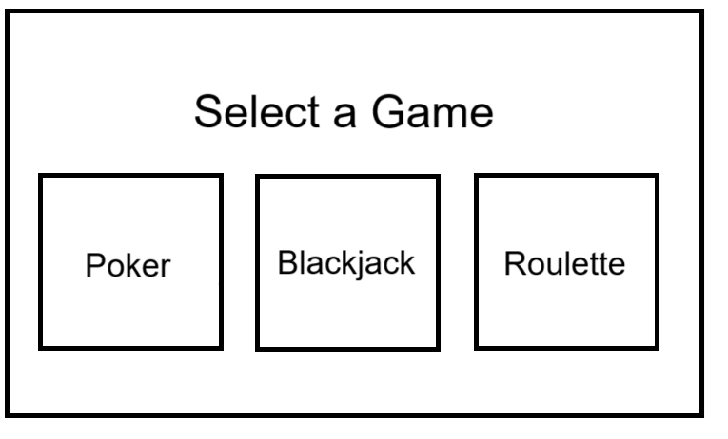
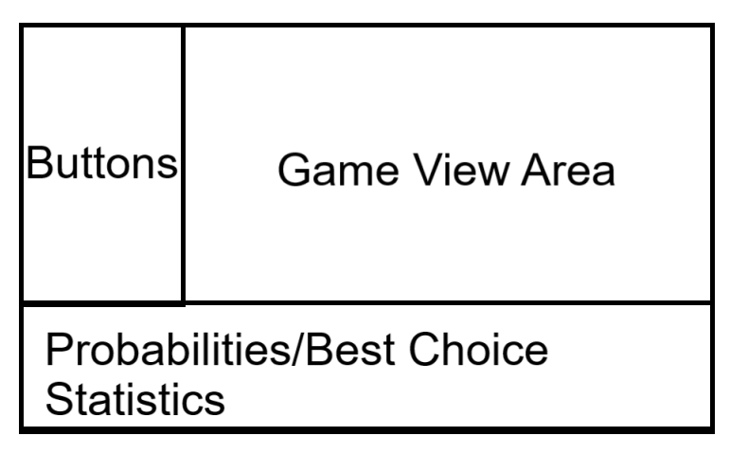
Proposed User Interface
-Main menu allowing the user to select 1 of the games
Once a game is selected:
Visual of the selected game with animations
Statistics bar at the bottom displaying all necessary stats of the given game
User controls on the left of the window to change different aspects of the game
ML

Slide 9

Next Steps
For deliverable 2 and 3, the following will be completed. Made simpler and easier due to the segmented implementation philosophy of this application:
Ares: sprites, styling, menus (scenebuilder), intricacies and project libraries setup, animations, card class, all game view areas, roulette.
Mark: BlackJack, blackjack strategy/dealer dialogue, game hints
Iles: cryptographic wrapper for rng, mines and dice game,
Michael: Poker, poker value calculator, menu (back end), poker player class
AG

Slide 10
Useful libraries
jCards – an Open-Source Java playing card manipulation library
https://github.com/lyudaio/jcards
Apache Commons Mathematics/Stats library – an Open-Source library for statistical analysis
https://commons.apache.org/proper/commons-math/userguide/stat.html
AG

Slide 11
Thank you!
AG

